Slide 1
George Strake District
Program Previews 2018 - 2019

Slide 2
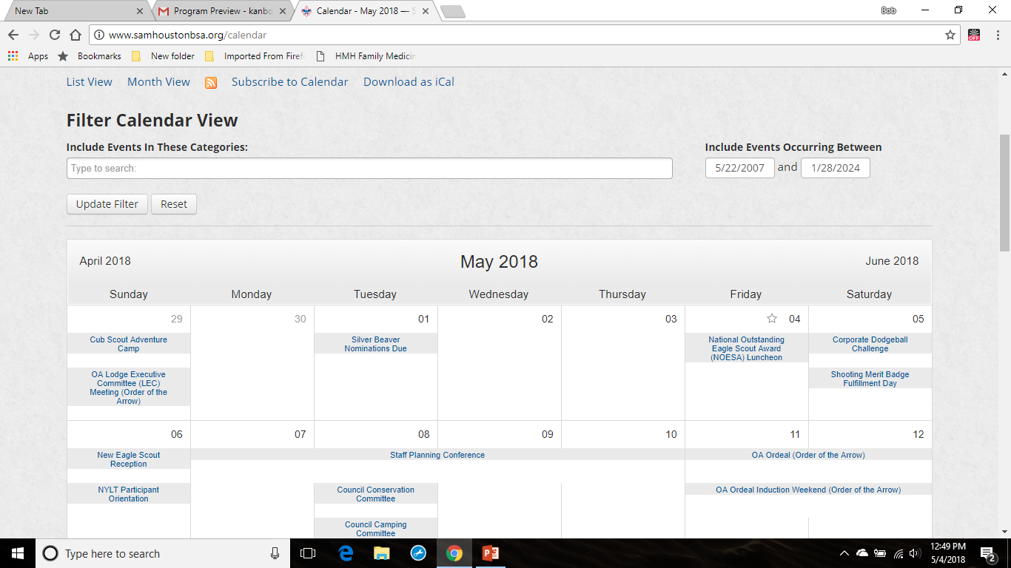

Slide 3
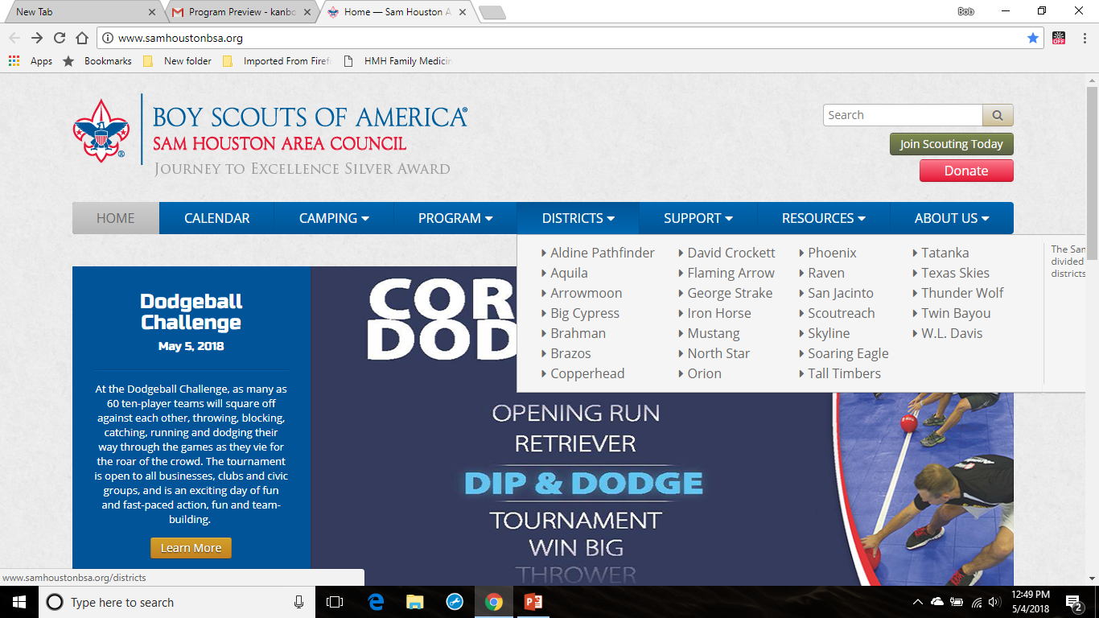

Slide 4
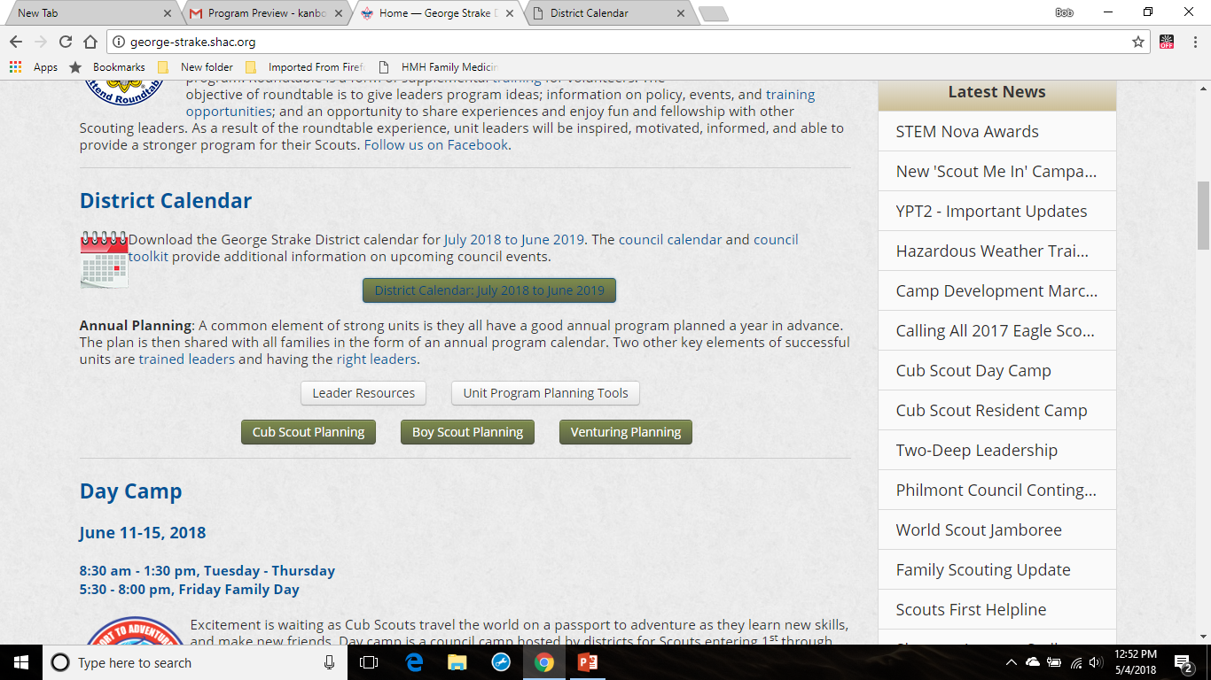

Slide 5
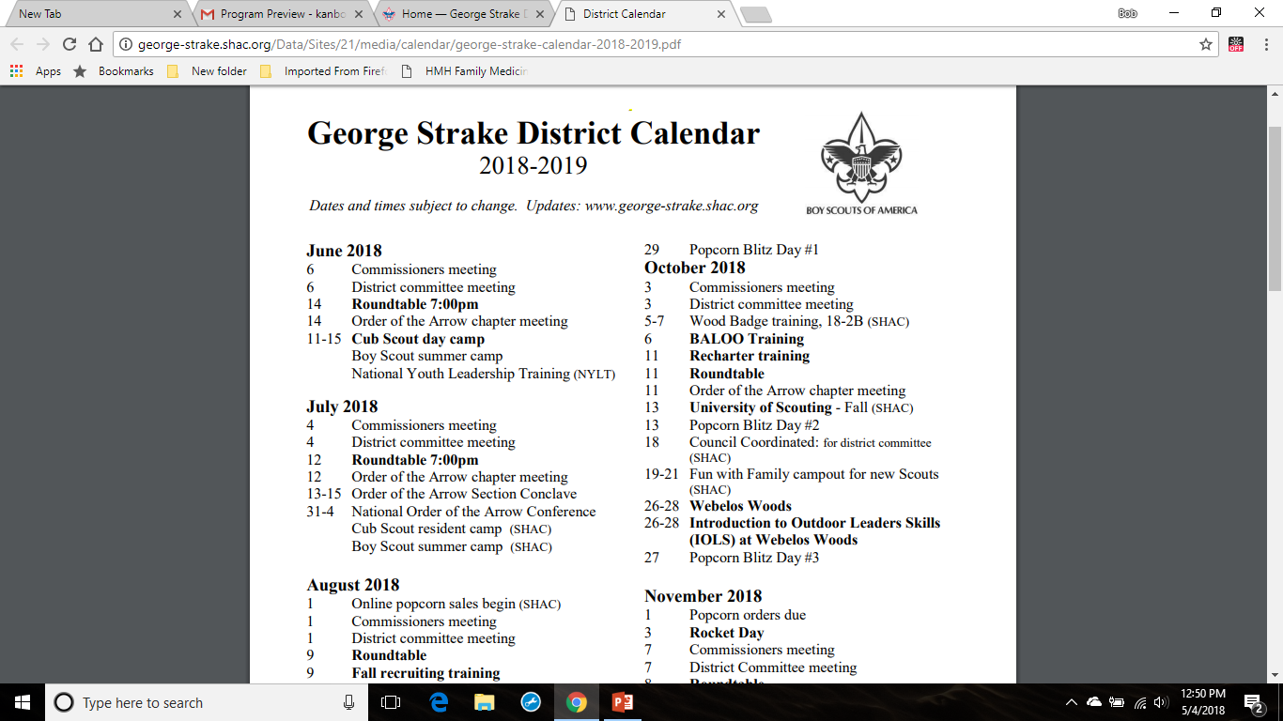

Slide 6
June 2018

Slide 7
Cub Scout Summer Day Camp
June 11-15, 2018
8:30 am - 1:30 pm, Tuesday - Thursday 5:30 - 8:00 pm, Friday Family Day
Church of Jesus Christ of Ladder Day Saints 2495 Ed Kharbat Dr. Conroe, Texas 77301
For more information and registration go to http://george-strake.shac.org/day-camp

Slide 8
National Youth Leadership Training (NYLT)
Sunday, June 10, 2018 All Day - Friday, June 15, 2018
Tellepsen Scout Camp at Bovay Scout Ranch
For more information and registration go to http://www.samhoustonbsa.org/national-youth-leadership-training-nylt--2018-06-10

Slide 9
July 2018

Slide 10
OA Lonestar Fellowship (Order of the Arrow) Section Conclave
Friday, July 13, 2018 All Day - Sunday, July 15, 2018
The University of the Incarnate Word, San Antonio
For more information and registration go to http://samhoustonbsa.doubleknot.com/registration/calendardetail.aspx?ActivityKey=2338150&OrgKey=3203

Slide 11
National Order of the Arrow Conference (NOAC)
Monday, July 30, 2018 All Day - Saturday, August 4, 2018
Indiana University
For more information and registration go to http://oa.samhoustonbsa.org/noac

Slide 12
August 2018

Slide 13
August 1, 2018
Online popcorn sales begin
Show and Sell orders are due
To sign up your unit for Popcorn sales go to http://www.samhoustonbsa.org/Secure/Login.aspx?returnurl=http%3a%2f%2fwww.samhoustonbsa.org%2fpopcorn-sign-up
August 14, 2018 Popcorn kickoff for unit popcorn kernel

Slide 14
Venturing Banquet
Saturday, August 18, 2018, 6:00 PM to 9:00 PM
Cockrell Scout Center (2225 North Loop West, Houston, 77008
The Venturing Banquet is the annual awards banquet where your peers and leadership will be presented with recognition for their work in the Venturing and Sea Scout programs. At the banquet the new Venturing Officer’s Association leadership will be announced.

Slide 15
September 2018

Slide 16
Order of the Arrow Elections
September 1 - November 20, 2017
Once each year, a troop may hold a unit election to elect youth members of their troop to become members of the Order of the Arrow. Both youth and adult Scouts and Scouters can become members of the OA, but only youth members are elected. Assistant Scoutmasters under the age of 21 are considered youth members for OA purposes. New members are voted on by every youth member of the troop present at the election - not just the OA members.
Elections are normally held at a regular troop meeting, and take about half an hour to complete. In order for an election to be held, at least 50% of your active youth members must be present – if less than 50% are present, the election must be rescheduled.
The OA elections must be completed by a trained election team with support of unit Arrowmen, the OA troop representative and the unit leader. Colonneh Lodge follows all Order of the Arrow policies contained in the Guide to Unit Elections.
To schedule an election go to http://george-strake.shac.org/request-election

Slide 17
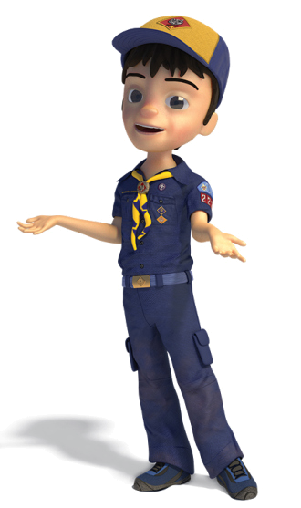
Fall recruiting nights
Units will be notified when and where by their Unit Commissioners and District Membership Chair
New Programs such as
For more information go to http://www.samhoustonbsa.org/lion

Slide 18
Family Scouting (From the National Website)
Serving Today’s Families
The BSA’s mission is to prepare young people to make ethical and moral choices over their lifetimes by instilling in them the values of the Scout Oath and Scout Law.
Our priority is to bring the benefits of Scouting to more youth while remaining true to our mission.
We are excited to announce beginning in 2018, our Cub Scouting program will be open to boys and girls. By welcoming both girls and boys into the program, even more youth will have access to the character development and values-based leadership that Scouting promises and be better prepared for future success.
For more information https://www.scouting.org/familyscouting/

Slide 19
Wood Badge is leadership training for all Scout Leaders who are involved in the programs of the Boy Scouts of
America – Cub Scouting, Boy Scouting, Varsity Scouting, and Venturing, as well as council and district leaders.
Next Course is S3-576-18-2: September 14 – 16 and October 5 – 7, 2018 (Fri – Sun) at Bovay Scout Ranch, 3450 County Rd 317, Navasota, TX 77868
To register go to http://www.samhoustonbsa.org/wood-badge

Slide 20
OA Fall Pow Wow (Order of the Arrow)
Friday, September 21, 2018 All Day - Sunday, September 23, 2018
Location McNair Cub Adventure Camp at Bovay Scout Ranch
The Order of the Arrow (OA) Fall Pow Wow is Colonneh Lodge's premier event. It is a combination of sports, games, expos, shows, ceremony competitions, Native American crafts, Pow Wows, and so much more. OA Fall Pow Wow is three days of non-stop fun, food, fellowship and celebration. Don’t miss the annual Vigil call out following the Saturday evening show.
For information and registration go to http://oa.samhoustonbsa.org/fall-pow-wow

Slide 21
Popcorn Blitz Day #1
Saturday, September 29, 2018 All Day
On popcorn blitz days, units will be encouraged to canvas their neighborhoods selling popcorn. There will be special drawings for prizes for Scouts who meet specific goals.
For more information go to http://www.samhoustonbsa.org/popcorn/#Blitz

Slide 22
October 2018

Slide 23
BALOO: Basic Adult Leader Outdoor Orientation (C32)
October 5-6, 2018 at Josey Scout Lodge, 2201 Avenue M, Huntsville, TX 77340
BALOO (Basic Adult Leader Outdoor Orientation) is the Cub Scout leader training required for any Cub Scout den or pack outdoor event, including packing camping, overnighters and Webelos den overnighters. BALOO training is now comprised of two components* – an online component, and a practical, hands-on component. Both components must be completed to qualify as a “Trained” Cub Scout outdoor leader and to receive the BALOO recognition patch. The online component contains introductory and basic information and must be completed prior to the practical component at my.scouting.org. The practical component is an overnight that takes about 16-hours to complete.
To register go to http://george-strake.shac.org/training-registration

Slide 24
University of Scouting
October 13, 2018
Location to be determined.
University of Scouting is a semi-annual training event for Cub Scout, Boy Scout, Venturing, Sea Scouts, district and council leaders and parents. It is an action-packed, fun-filled single day of supplemental training where participants choose from over 100 courses. Sessions are led by experienced volunteers who will help you enhance your ability to deliver a fun and exciting program to the Scouts. This unique day of seminars provides information, techniques, and best practices on how to improve your Scout program. Whether you are new to the program or a veteran of many years, the University of Scouting has something for you.
Registration opens in August 2018 at http://www.samhoustonbsa.org/university-of-scouting

Slide 25
Popcorn Blitz Day #2
Saturday, October 13, 2018 All Day
On popcorn blitz days, units will be encouraged to canvas their neighborhoods selling popcorn. There will be special drawings for prizes for Scouts who meet specific goals.
For more information go to http://www.samhoustonbsa.org/popcorn/#Blitz

Slide 26
Fun with Family
October 19-20 or 20-21, 2018
Fun with Family is an overnight campout for newly registered Cub Scouts and their adult partner and families at Bovay Scout Ranch (3450 County Rd 317, Navasota, TX 77868). Scouts can participate in BB guns, archery, sling shots, crafts, rockets, sports, campfire and more.
Registration opens in September!
The registration fee is $24 per participant and includes an event patch, activity supplies, snacks and two meals. Register early as sessions fill up quickly.
Volunteer Registration
Fun with Family is run by volunteers. Volunteers help with check-in, run program areas (e.g., BB guns, archery, crafts, rockets), serve in the dining hall, assist with parking and staff the first aid area. Volunteer registration can be done by individuals or unit leaders.
Volunteer sign-up opens in August!

Slide 27
Webelos Woods
October 26-28, 2018
Webelos Woods is a special weekend designed for 4th and 5th grade Webelos Scouts and their parents to experience some of what awaits them in Boy Scouts. Fourth grade Webelos and their parents are invited to attend Saturday and work on adventure loops as well as visit with local troops. Fifth grade Webelos Scouts and at least one parent can camp with a host troop and learn more about the patrol method while enjoying many activities.
Registration opens in August!

Slide 28
Introduction to Outdoor Leaders Skills (IOLS) at Webelos Woods
October 26-28, 2018
Working as patrols, this hands-on course provides adult leaders the practical outdoor skills they need to lead Scouts in the out-of-doors. Upon completion, leaders should feel comfortable teaching Scouts the basic skills required to obtain the First Class rank. Along with basic training, this course is required of all direct contact leaders registered in Boy Scout troops in order to be considered trained. The training is a weekend course and takes about 15 hours to complete.
Registration will open in August.

Slide 29
Popcorn Blitz Day #3
Saturday, October 27, 2018 All Day
On popcorn blitz days, units will be encouraged to canvas their neighborhoods selling popcorn. There will be special drawings for prizes for Scouts who meet specific goals.
For more information go to http://www.samhoustonbsa.org/popcorn/#Blitz

Slide 30
November 2018

Slide 31
Popcorn orders are due
November 1, 2018

Slide 32
Rocket Launch Day
November 3, 2018
Tri-County Barnstormers Field 916 Tafelski Rd. New Waverly, TX 77458
10:00 am - 12:00 pm
Boys who join Cub Scouts this year will receive a rocket that they can design, build, and launch at Rocket Day. Boys in first through fifth grade who are interested in joining Scouting may also attend. We will help you find a pack near you and get signed up for Scouting. A very limited number rockets might be available for purchase for returning Scouts, but are not guaranteed.
Registration go to http://george-strake.shac.org/register-for-rocket-day

Slide 33
Popcorn Distribution
November 17, 2018
Silver Eagle Conroe 2617 Industrial Ln, Conroe, TX 77301

Slide 34
Council Recognition Reception
November 27, 2018, 7:30 pm Chapelwood United Methodist Church 11140 Greenbay St., Houston TX 77024
The Council Recognition Reception is held annually to honor the recipients of the Silver Beaver Award and Heroism Awards. Join your fellow Scouters in recognizing the recipients of the Silver Beaver Award, the highest award a council can bestow on a volunteer Scouter. The William H. Spurgeon III Award and Lifesaving and Meritorious Awards are also presented.

Slide 35
December 2018

Slide 36
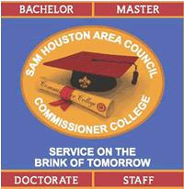
College of Commissioner Science
Saturday, December 1, 2018 8:00 AM to 4:00 PM
Cockrell Service Center (2225 North Loop West, Houston, 77008
The College of Commissioner Science is a day of training for commissioners from Commissioner Basic Training through advanced learning experiences in unit service. The objectives are to help commissioners expand their skills and unit service philosophy. The goal of this experience is to promote the increased effectiveness of the individual commissioner.
This ongoing training opportunity will benefit new commissioners and experienced unit commissioners. Any adult leader that is curious about the numerous resources available in the Scouting movement is also invited to attend.
For information and registration http://www.samhoustonbsa.org/college-of-commissioner-science

Slide 37
Recharter turn-in at roundtable
December 6, 2018

Slide 38
Top Leader Training Day
Saturday, December 8, 2018 from 8:00 AM to 2:00 PM
Cockrell Scout Center, 2225 North Loop West, Houston, 77008
Top Leader Basic Training Day is an opportunity to train the top unit leaders (Cubmasters, Scoutmasters, Crew Advisors) before recharter. All top leaders must be trained before December recharter.
For more information and registration go to http://www.samhoustonbsa.org/top-leader-basic-training-day

Slide 39
Scouts, BSA Winter Camp
Wednesday, December 26, 2018 All Day - Monday, December 31, 2018 at Bovay Scout Ranch, 3450 County Rd 317, Navasota, TX 77868
Unit and Staff Registration opens in October at http://www.samhoustonbsa.org/winter-camp

Slide 40
National Youth Leadership Training (NYLT)
Wednesday, December 26, 2018 All Day - Monday, December 31, 2018
Bovay Scout Ranch, 3450 County Rd 317, Navasota, TX 77868
National Youth Leadership Training (NYLT) is an exciting, action-packed six-day council-level program designed to provide Boy Scouts and Venturers with leadership skills and experience they can use in their home units and in other situations demanding leadership of self and others.
For more information and registration go to http://www.samhoustonbsa.org/nylt

Slide 41
January 2019

Slide 42
Scout Fair Kickoff (for unit leaders)
Thursday, January 24, 2019 from 7:00 to 8:30 PM
Various district locations
At the Scout Fair Kickoff, unit leaders receive training and materials for the Scout Fair coupon books sales, a brilliant way for units to raise money and prepare Scouts to earn their own way! Leaders will also receive information on how their unit can participate at Scout Fair, as either a service unit or booth participant to earn an additional 10% commission.

Slide 43
Scouting for Food
January 26, 2019 (hanger drop off)
The unit Scouting For Food chair should attend the December and January district roundtable to pick up your unit's supply of door hangers. If you are unable to attend roundtable, please contact your district professional or district Scouting for Food chair. All participating Scouts will receive a Scouting for Food patch. The unit Scouting for Food coordinator can pick up the patches at the March district roundtable.

Slide 44
George Strake District Awards Dinner
January 26, 2019
Josey Scout Lodge 2201 Avenue M, Huntsville, TX 77340

Slide 45
February 2019

Slide 46
Scouting for Food
February 2, 2019 (food pick up)

Slide 47
Scout Sabbath
Saturday, February 2, 2019 All Day
Scout Sabbath, for Jewish Scout units, is always the Saturday after Scout Sunday and offers an opportunity for worshippers to honor Scouts and Scouters, as well as to learn more themselves about the value of Scouting as a youth program chartered to a Jewish organization. It gives a rabbi a framework to address Scouts directly, in addition to speaking about Scouting to the congregation.
Scout Sunday
Sunday, February 3, 2019 All Day
The Boy Scouts of America designates the Sunday that falls before February 8 (Scouting Anniversary Day) as Scout Sunday, which is the primary date to recognize the contributions of young people and adults to Scouting. However, each chartered organization can use either of two other options to celebrate this special day.
The Scout units are urged to participate in the religious services. Scout Sunday is an opportunity for units can attend services in uniform, conduct a flag ceremony, speak about Scouting, present religious awards and/or formally thank the chartering organization for their support throughout the year, reserve pews, take an active participation in the service such as a prayer, request a notice in the church bulletin. Consider having a recruiting information table in the foyer or hospitality area. A Scout is Reverent.

Slide 48
Spring Recruiting
Packs are encouraged to hold spring recruiting events. Recruiting events can be any sort of fun activity that would entice elementary-aged boys to check out Scouting. This can be simply inviting potential recruits to an already scheduled summer pack activity, or it can be a separate event focused primarily on recruiting. Invite newly recruited Scouts and kindergarteners to attend day camp and pack summer events. Sometimes we think we can only recruit in the fall, but spring is a great time to get new Tigers and their families involved early. The council provides a variety of support materials for packs, including flyers.

Slide 49
Venturing Challenge
Breadcrumb Navigation
February 22-24, 2019
Bovay Scout Ranch 3450 County Road 317 Navasota, TX 77868

Slide 50
March 2019

Slide 51
Camporee
March 1-3, 2019
Bovay Scout Ranch, Duke Energy Camporee Site 3450 County Road 317 Navasota, TX 77868
Registration opens in February!

Slide 52
Introduction to Outdoor Leaders Skills (IOLS) at Camporee
March 1 – 3, 2019
Working as patrols, this hands-on course provides adult leaders the practical outdoor skills they need to lead Scouts in the out-of-doors. Upon completion, leaders should feel comfortable teaching Scouts the basic skills required to obtain the First Class rank. Along with basic training, this course is required of all direct contact leaders registered in Boy Scout troops in order to be considered trained. The training is a weekend course and takes about 15 hours to complete.

Slide 53
Scout Fair coupon books: 5% sales bonus deadline
March 7, 2019

Slide 54
University of Scouting
March 23, 2019
Location to be determined.
University of Scouting is a semi-annual training event for Cub Scout, Boy Scout, Venturing, Sea Scouts, district and council leaders and parents. It is an action-packed, fun-filled single day of supplemental training where participants choose from over 100 courses. Sessions are led by experienced volunteers who will help you enhance your ability to deliver a fun and exciting program to the Scouts. This unique day of seminars provides information, techniques, and best practices on how to improve your Scout program. Whether you are new to the program or a veteran of many years, the University of Scouting has something for you.

Slide 55
Scout Fair coupon books: 3% sales bonus deadline
March 28, 2019

Slide 56
April 2019

Slide 57
Scout Fair coupon books: 1% sales bonus deadline
April 1, 2019

Slide 58
Arrowman Bash / Ordeal (Order of the Arrow)
Friday, April 5, 2019 All Day - Sunday, April 7, 2019
Bovay Scout Ranch, 3450 County Rd 317, Navasota, TX 77868
Powder Horn (weekend #1)
Friday, April 5, 2019 All Day - Sunday, April 7, 2019
Tellepsen Scout Camp, 3450 County 317, Navasota, TX 77868

Slide 59
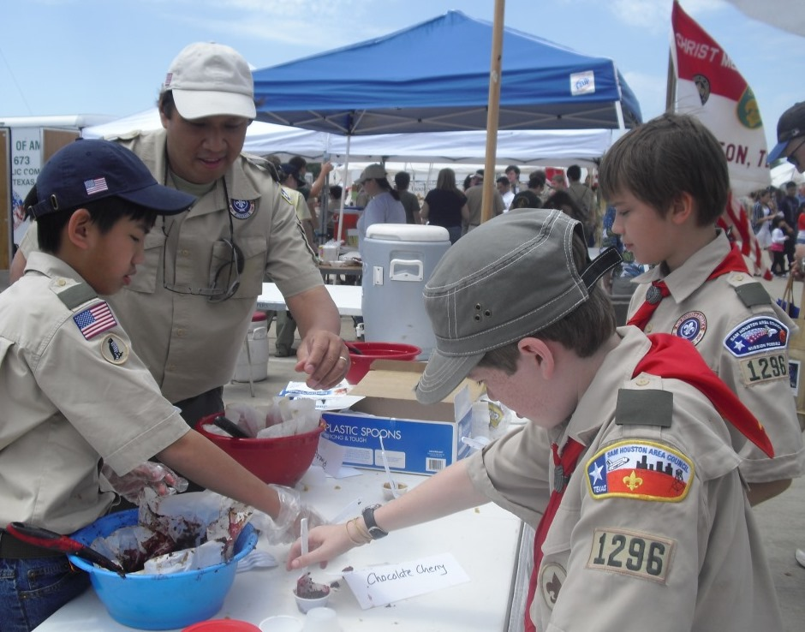
Scout Fair
Saturday, April 6, 2019 All Day
NRG Arena

Slide 60
Philmont Scout Ranch 101 (Orientation)
Saturday, April 6, 2019 1:00 PM
Philmont Scout Ranch is the Boy Scouts of America's largest national High Adventure Base. Its 34 staffed camps and 55 trail camps provide an unforgettable adventure in the high country along hundreds of miles of rugged, rocky trails.
Anyone interested in learning more about Philmont should attend. The Philmont orientation meeting covers:
What is Philmont.
Who can go to Philmont.
What to expect from Philmont
Council contingent versus individual unit registrations
Required trainings
Appropriate equipment to take to Philmont
Physical expectations for Philmont
Required health forms and weight limits
How to train for Philmont
What NOT to do at Philmont!
Cooking ideas and suggestions
Following the orientation, a council contingent leaders meeting (for this year's leaders) will be held to cover transportation, departure, contingent leader responsibilities, etc. and answer questions

Slide 61
Powder Horn (weekend #2)
Friday, April 26, 2019 All Day - Sunday, April 28, 2019

Slide 62
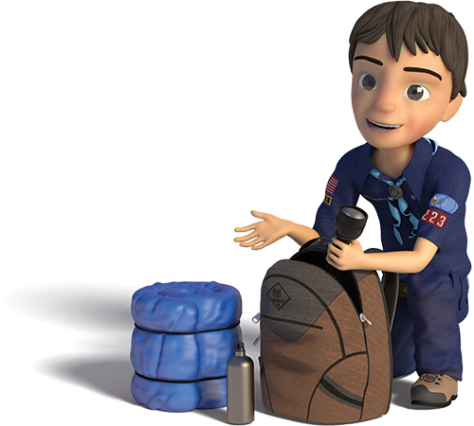
Spring Family Cuboree @ Josey Lodge
April 27, 2019

Slide 63
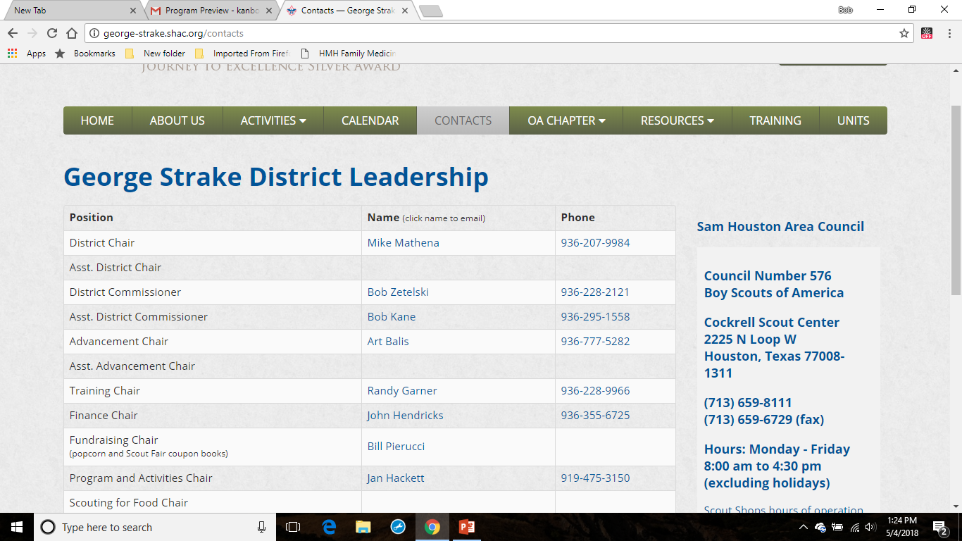
All events and activities for the George Strake District are planned and run by volunteers within the District. If you would like to volunteer your skills and experiences to plan and run an upcoming event please contact a member of the District Committee.

